Slide 1

When the company receives a loan application, the company has to make a decision for loan approval based on the applicant’s profile.
Two types of risks are associated with the bank’s decision:
If the applicant is likely to repay the loan, then not approving the loan results in a loss of business to the company
If the applicant is not likely to repay the loan, i.e. he/she is likely to default, then approving the loan may lead to a financial loss for the company

Slide 2
Contents
Requirement
Data understanding
Data cleaning
Data analysis
Recommendations

Slide 3
Requirement

Slide 4
The aim is to identify the patterns which indicate if a person is likely to default, which may be used for taking actions such as denying the loan, reducing the amount of loan, lending (to risky applicants) at a higher interest rate, etc.
When a person applies for a loan, there are two types of decisions that could be taken by the company:
Loan accepted: If the company approves the loan, there are 3 possible scenarios described below:
Fully paid: Applicant has fully paid the loan (the principal and the interest rate)
Current: Applicant is in the process of paying the instalments, i.e. the tenure of the loan is not yet completed. These candidates are not labelled as 'defaulted'.
Charged-off: Applicant has not paid the instalments in due time for a long period of time, i.e. he/she has defaulted on the loan
Loan rejected: The company had rejected the loan (because the candidate does not meet their requirements etc.). Since the loan was rejected, there is no transactional history of those applicants with the company and so this data is not available with the company (and thus in this dataset)

Slide 5
Data understanding

Slide 6
In this case study, we have used EDA to understand how consumer attributes and loan attributes influence the tendency of default.
Libraries used:
Numpy
Pandas
Matplotlib
Seaborn
Datetime
The Loan dataset contains 39,717 records comprising of 111 features

Slide 7
Data cleaning

Slide 8
Total number of columns having missing values = 68 (61.26%)
54 columns/features have NULL values
14 columns/features have missing values (NOT NULL)
There are 10 features which has <30% missing values
There is only one feature (desc) which has >30% & <60% missing values
There is only one feature (mths_since_last_delinq) which has >60% & <90% missing values
Only 2 features (mths_since_last_record & next_pymnt_d) who have more than >90% & <100% missing values
There are no rows with high percentage of missing values.

Slide 9
Data analysis

Slide 10
Few important features which will help us in identifying whether the loan applicant will be a Defaulter or Non-Defaulter:
loan_amnt
Term
int_rate
Grade
sub_grade
emp_length
home_ownership
annual_inc
verification_status
issue_d
purpose
dti
The target feature/column is loan_status

Slide 11
Defaulters = 14.6 %
Non-Defaulters = 85.4 %

Slide 12
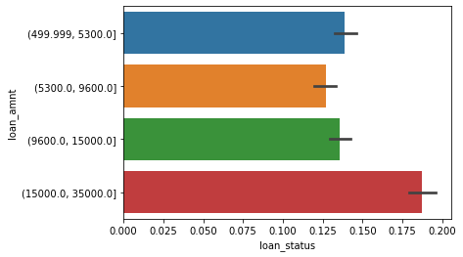
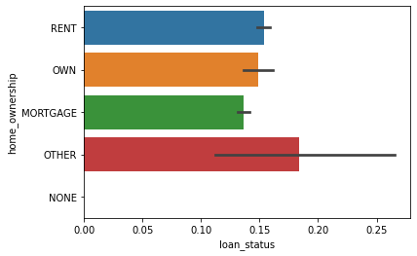
Default rate is high when loan amount is in the range of (15000, 35000)
Default rate is high in home ownership of type Others

Slide 13
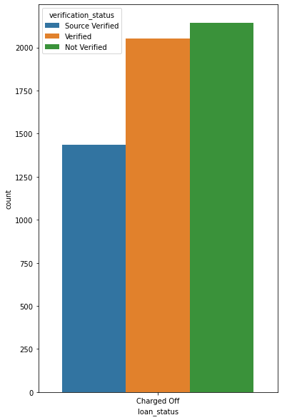
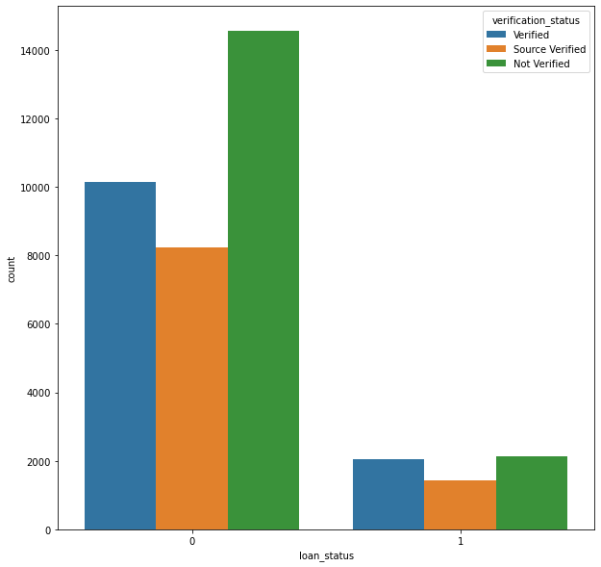
Not Verified loans have high chances of being Default

Slide 14
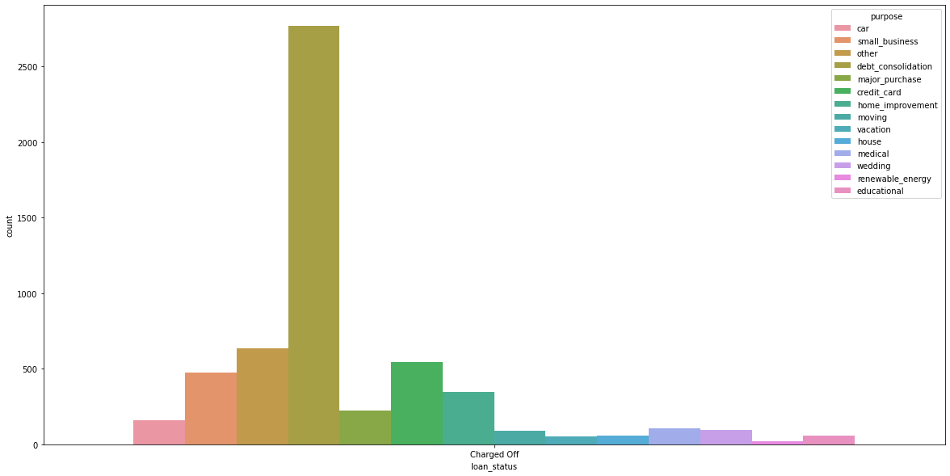
Default rate is high when loan is availed for Debt consolidation purpose

Slide 15
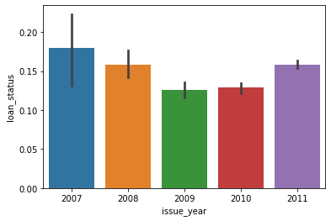
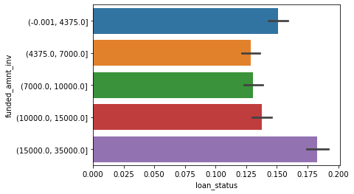
Loans availed in the year 2007 have maximum default rate
Default percentage is high when investor invests the amount in the range of (15000, 35000)

Slide 16
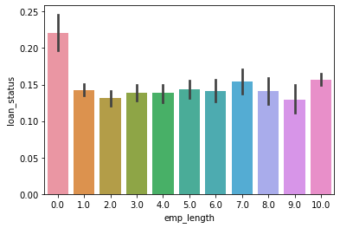
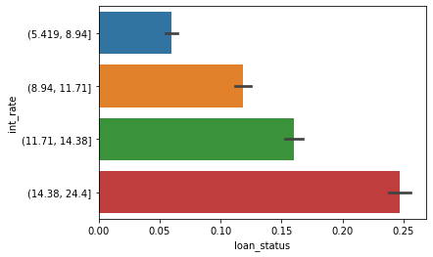
Default percentage is high when loans have a interest rate of more than 14%
Loan applicants whose employee length is n/a (0) have high chances of getting defaulted. Next category is employees having more than 10+ years

Slide 17
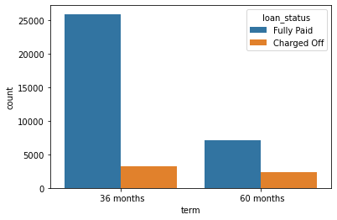
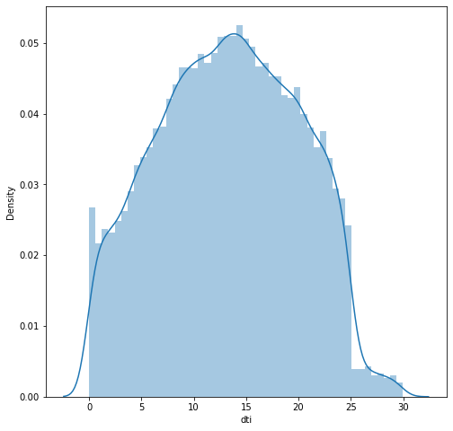
Default rate is high when loan term is 36 months
Default rate is high when dti is in the range of (13, 25)

Slide 18
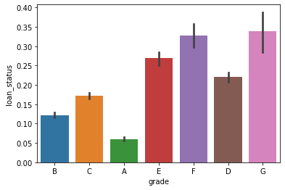
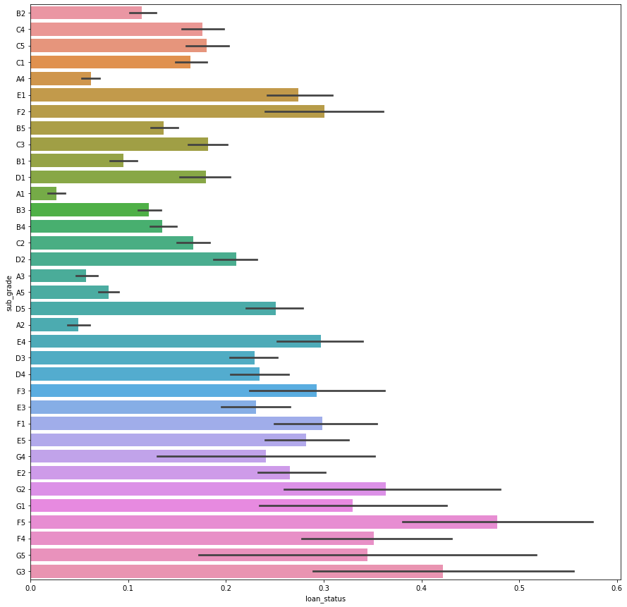
Default percentage is high in the grades belonging to F and G having sub-grades F5 and G3 respectively

Slide 19
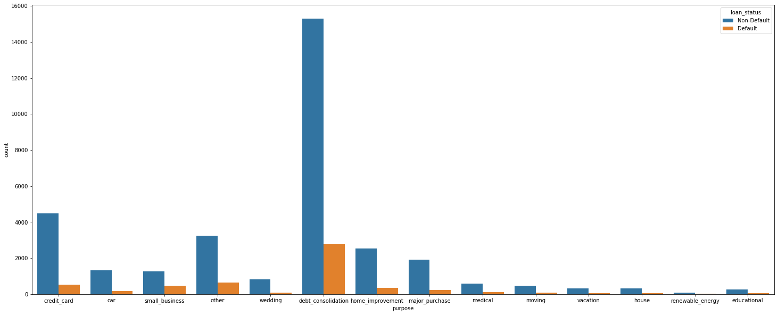
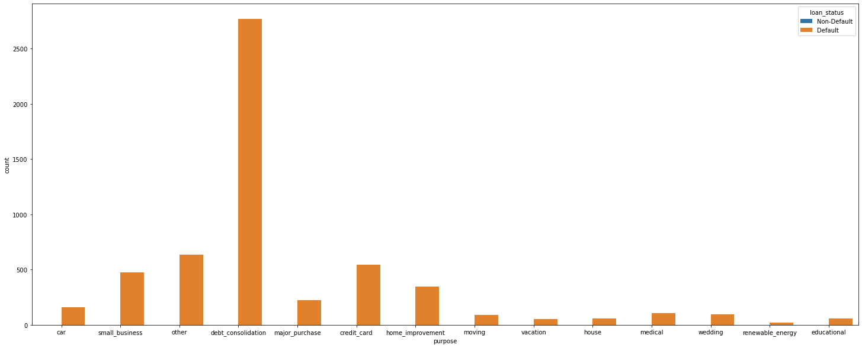
Default rate is high for debt_consolidation category

Slide 20
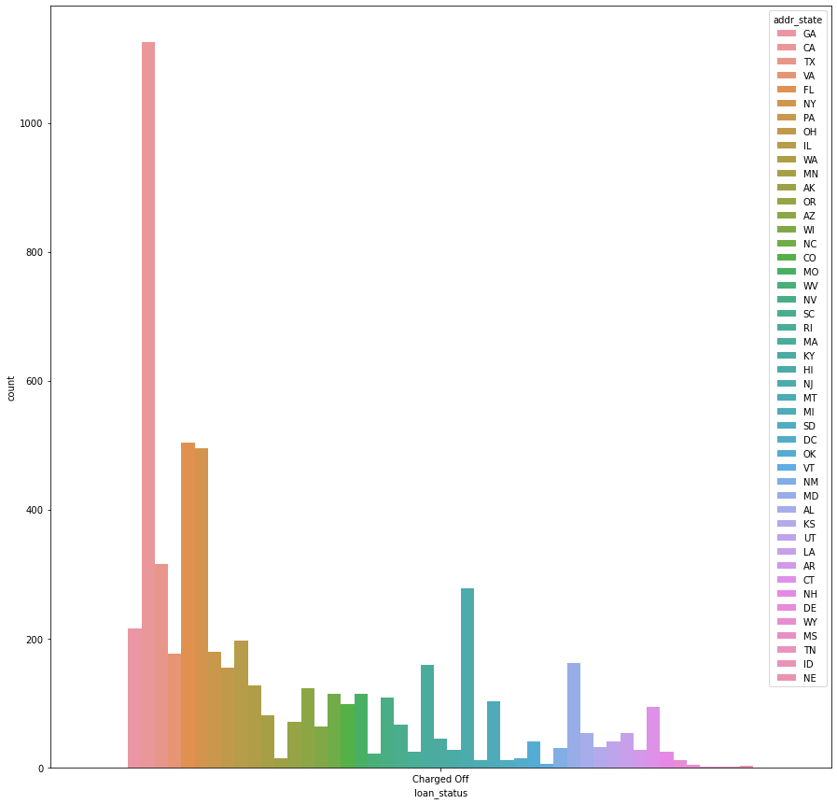
Default rate is very high in CA (California) state

Slide 21
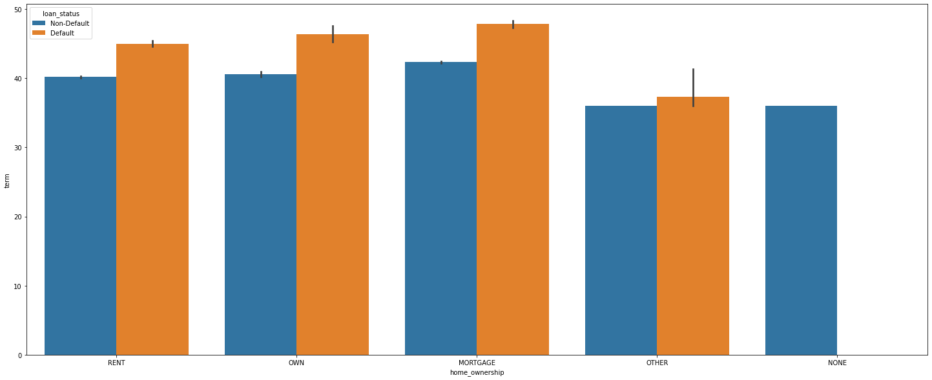
Default percentage is high if term is more than 36 months across following categories of home_ownership:
OTHER --> 100%
OWN --> 28.34%
RENT --> 28.04%
MORTGAGE --> 22.84%

Slide 22
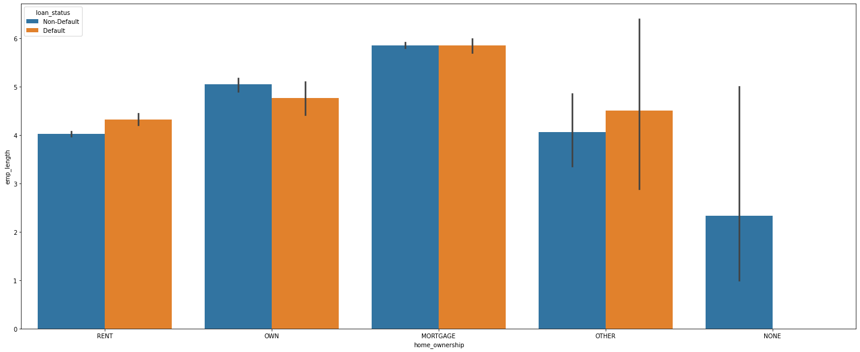
Maximum defaulters are found in OTHER category of home_ownership whose emp_length is more than 4 years

Slide 23
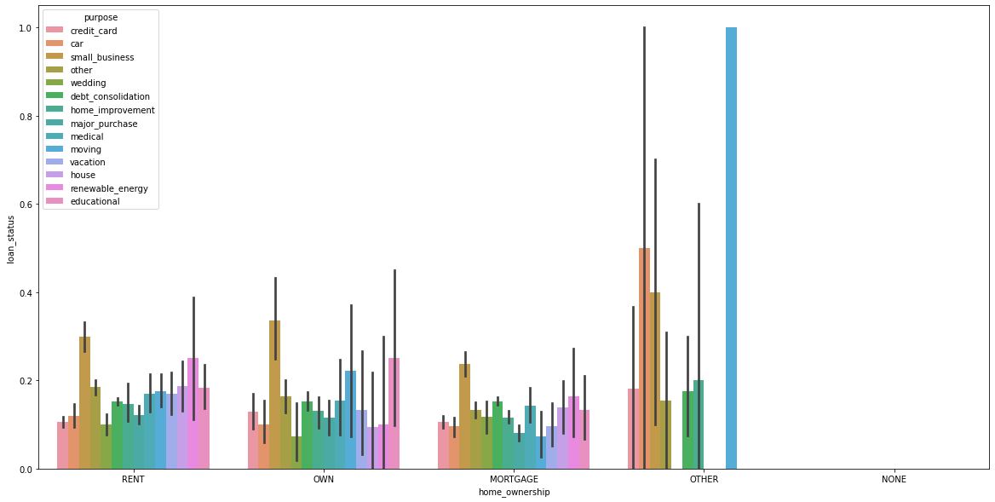
Default percentage is high for the following combinations of home_ownership category and purpose:
OTHER * moving --> 100%
OWN * small_business --> 33.66%
RENT * small_business --> 29.92%
MORTAGE * small_business --> 23.83%

Slide 24
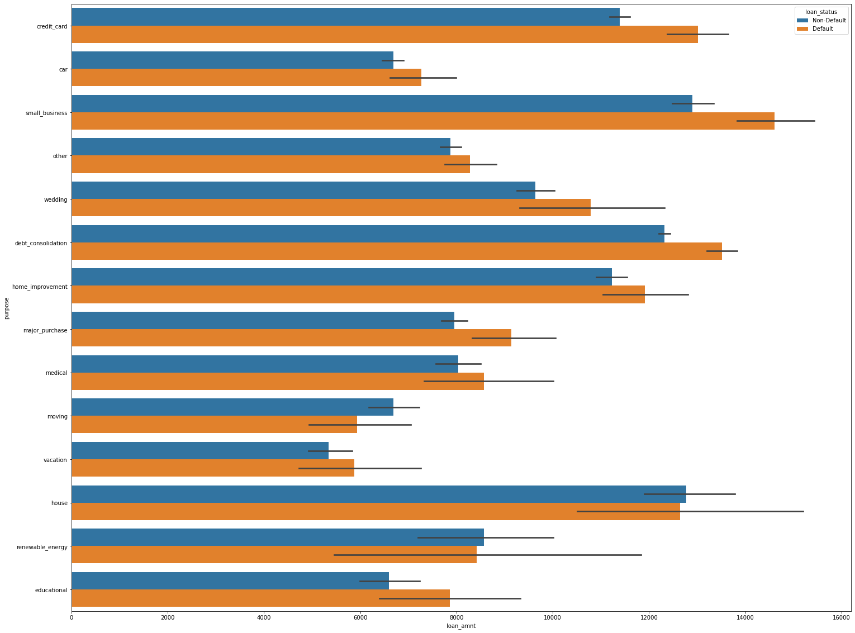
Default percentage is higher when loan_amnt issued is higher (>10000) for small_business purpose

Slide 25
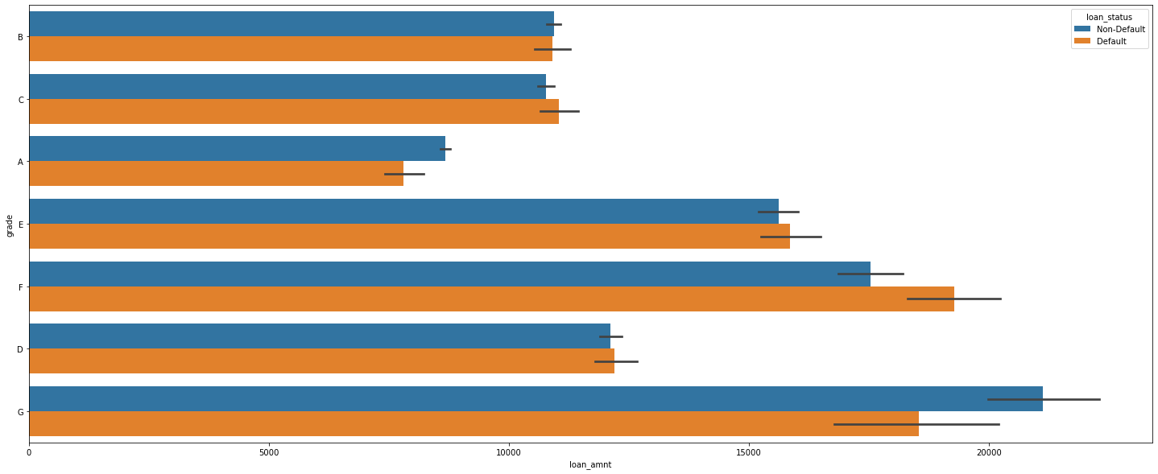
Default percentage is 45.1% for grade F when loan_amnt is greater than 15000

Slide 26
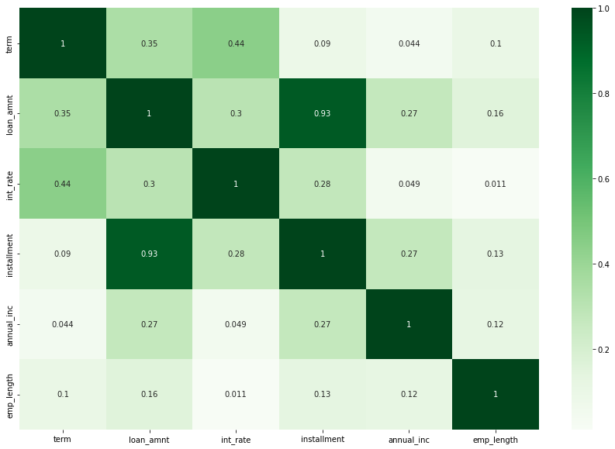
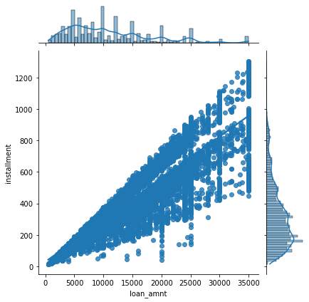
From the heatmap and regression plot, it is very clear that there is a high correlation between loan_amnt and installment (0.93) i.e., as the loan amount increases, the instalments also increases.

Slide 27
Recommendations

Slide 28
Features which are highly influencing the Default v/s Non-Default loans are as follows:
Loan amount
Term
Grade
Home Ownership
Purpose
Verification status
Points to consider before approving the loan:
Default percentage is high when loan amount is in the range of (15000, 35000)
Not Verified loans have high chances of being Default
Default rate is high when loan is availed for Debt consolidation purpose
Default percentage is high when investor invests the amount in the range of (15000, 35000)
Default percentage is high when loans have a interest rate of more than 14% and loan term is 36 months
Default percentage is high in the grades belonging to F and G
Maximum defaulters are found in OTHER category of home_ownership whose emp_length is more than 4 years
Default percentage is higher when loan_amnt issued is higher (>10000) for small_business purpose

